Slide 1

STUDENT RESULT PUBLICATION
Project Supervisor: MS.R.YOGITHA
Student name:KARRI VISHNU SAI RAMA REDDY
Reg.No:40110552

Slide 2

Course Certificate

Slide 3
Introduction
The main purpose / objective of this study is to develop and automate the management and publication of student results using a computer system
It covers the full details of the students' studies and includes the student's registered number, marks, amount, and rating.
It can be accessed by principals who can use the portfolio to analyse results
This document aims to define theoverall software requirements for the Student Outcomes
Management System (SRP) and, tries to define conditions to be more robust and accurate.
This is also a Major Result Management System Project, which you can submit in final year. But if you need Mini Project on Result Management
criteria for Subject, Student, Result also admin can perform Create, read, update and delete (CRUD) operations on Teacher, Semester, Class.

Slide 4
Objective
The main objective of the project is to provide the examination result to the student in a simple way. This project is useful for students and institutions for getting the results in simple manner By
a result analyser with subject status and marks is an application tool for displaying the results in secure way.
The system is intended for the student. And the privileges that are provided to student are to read and execute his/here result by providing user name and password for secure login and in case of new student the registration is available. And the guest user has the privilege only to read.
In this project, there are various type of modules available to manage Result, Subject, Student. We can also generate reports for Subject, Student,
developed for managing Teacher, Semester module manages Semester operations, Result module has been implemented to manage Result.

Slide 5
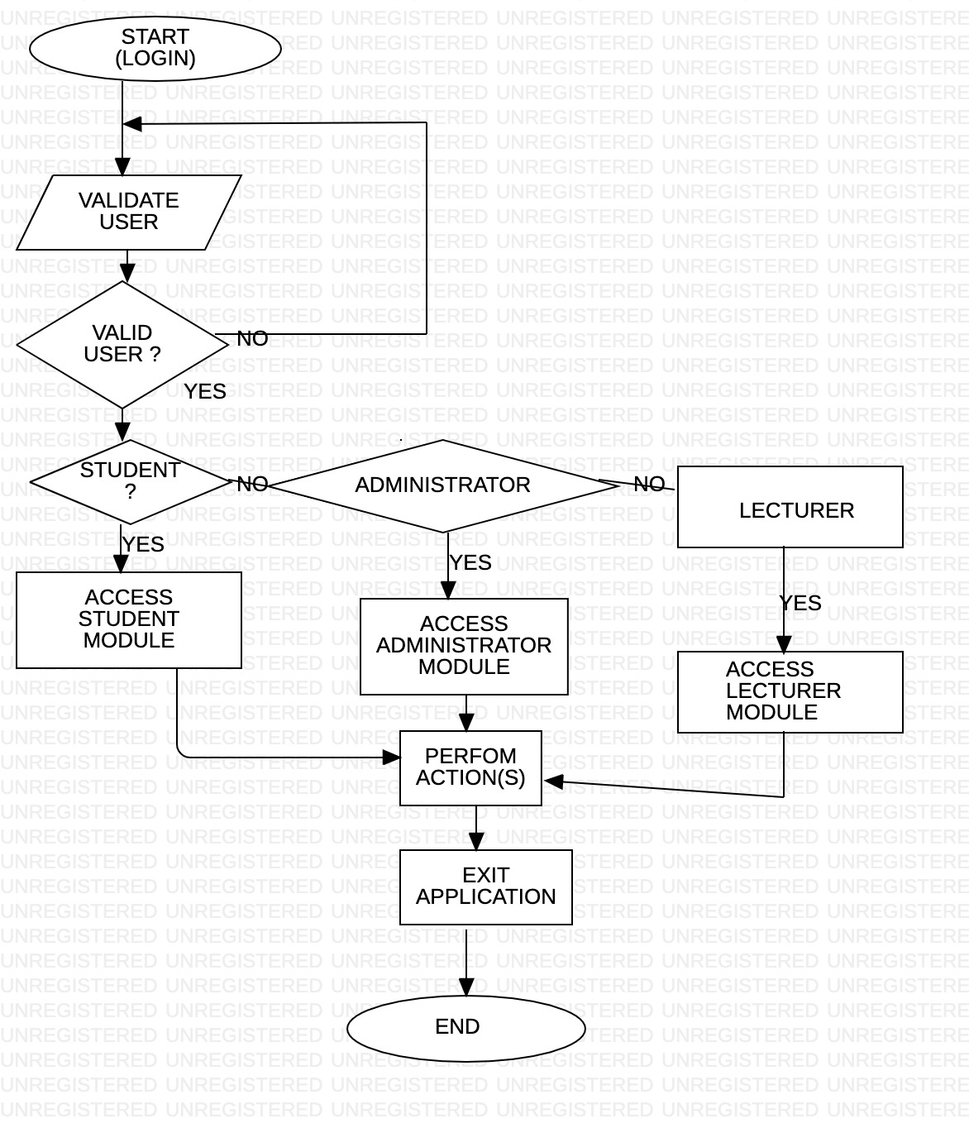
Ideation Diagram

Slide 6
Project implementation
Software Requirements
Visual Studio
PHP
HTML,CSS
Xamp Server
Hardware Requirements
Intel core i5 10th Gen Processor
Ram: 8 Gb
Operating System: Windows, MacOS

Slide 7
Module implementation
HTML,CSS
PHP
Xamp Server

Slide 8
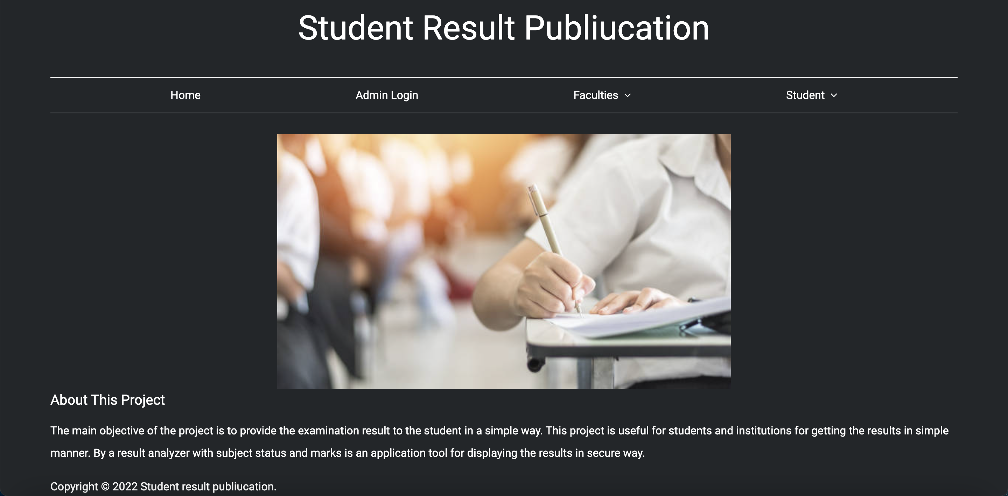
Application Snapshots

Slide 9
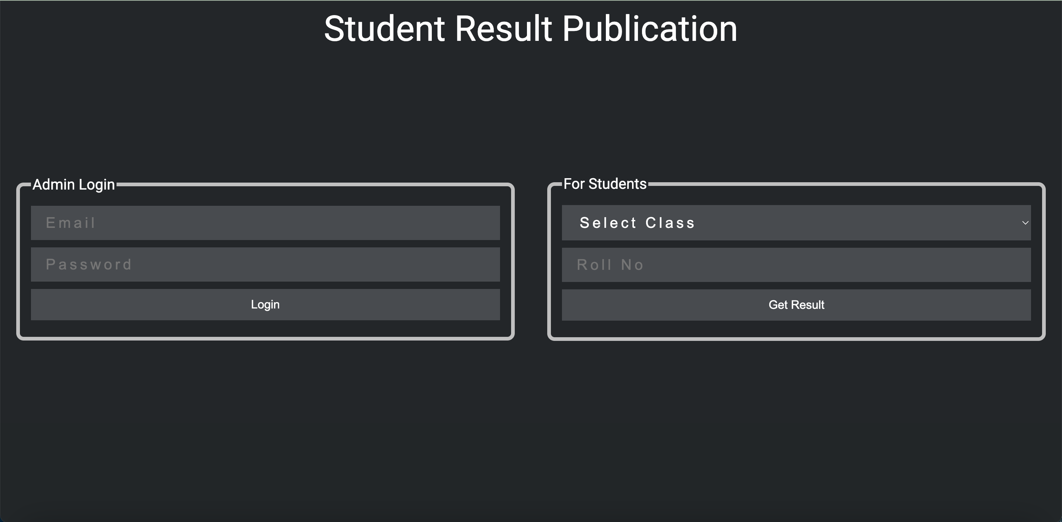
Admin and Student Login Page

Slide 10
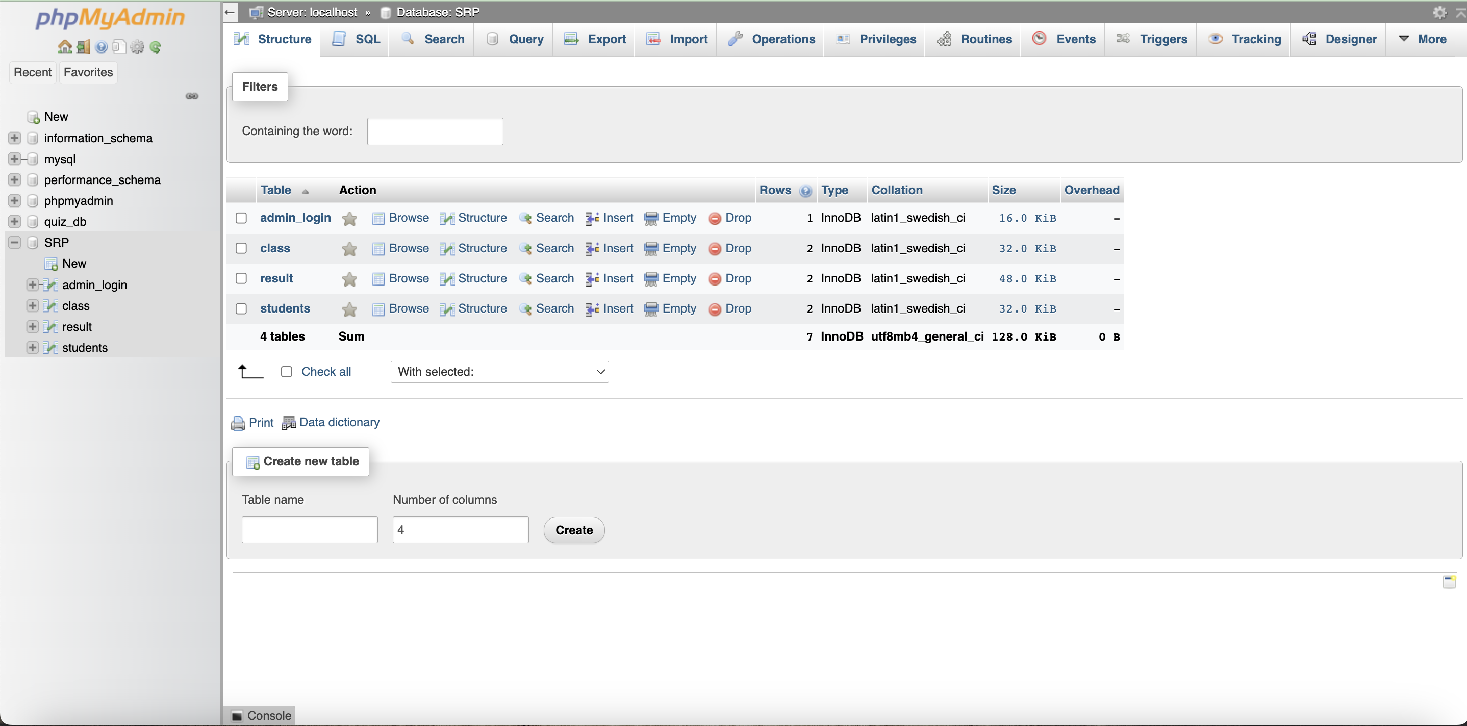
Admin Database

Slide 11
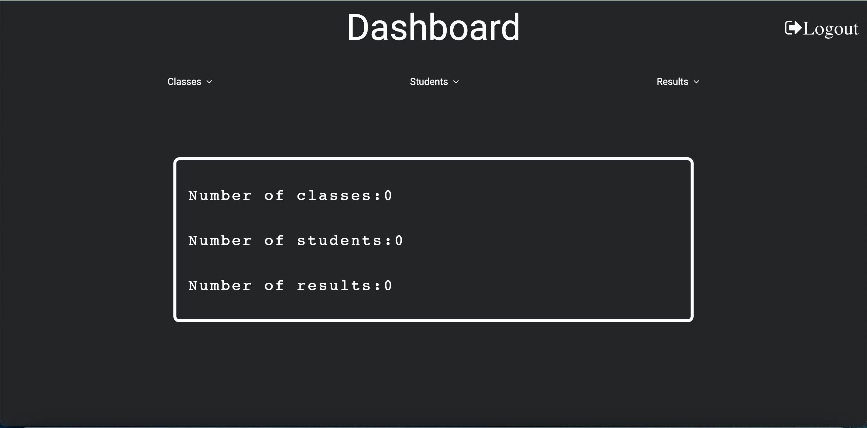
Admin Dashboard

Slide 12
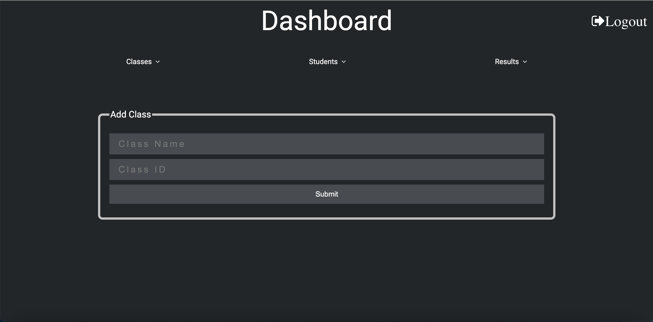
Admin Add The Classes

Slide 13
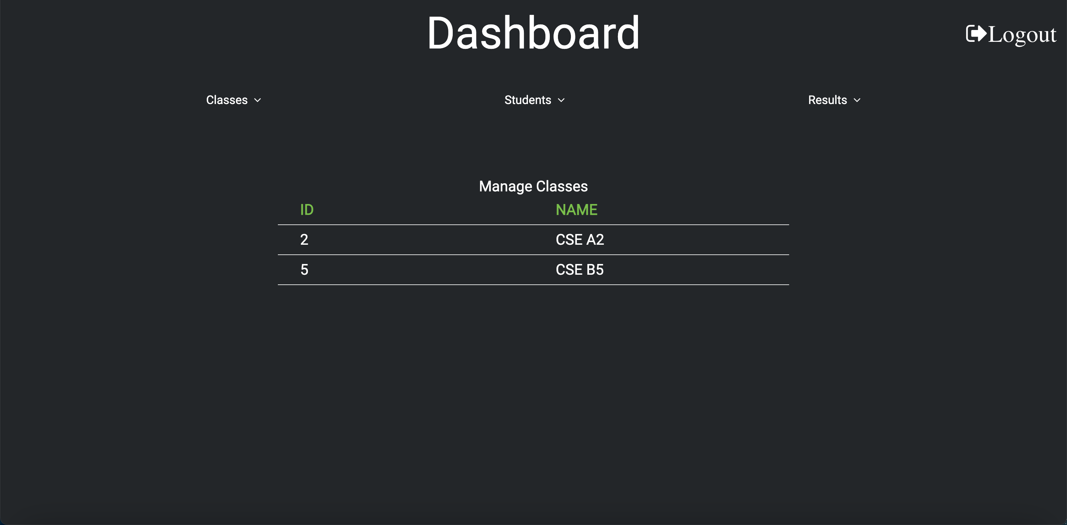
Admin Manages The Classes

Slide 14
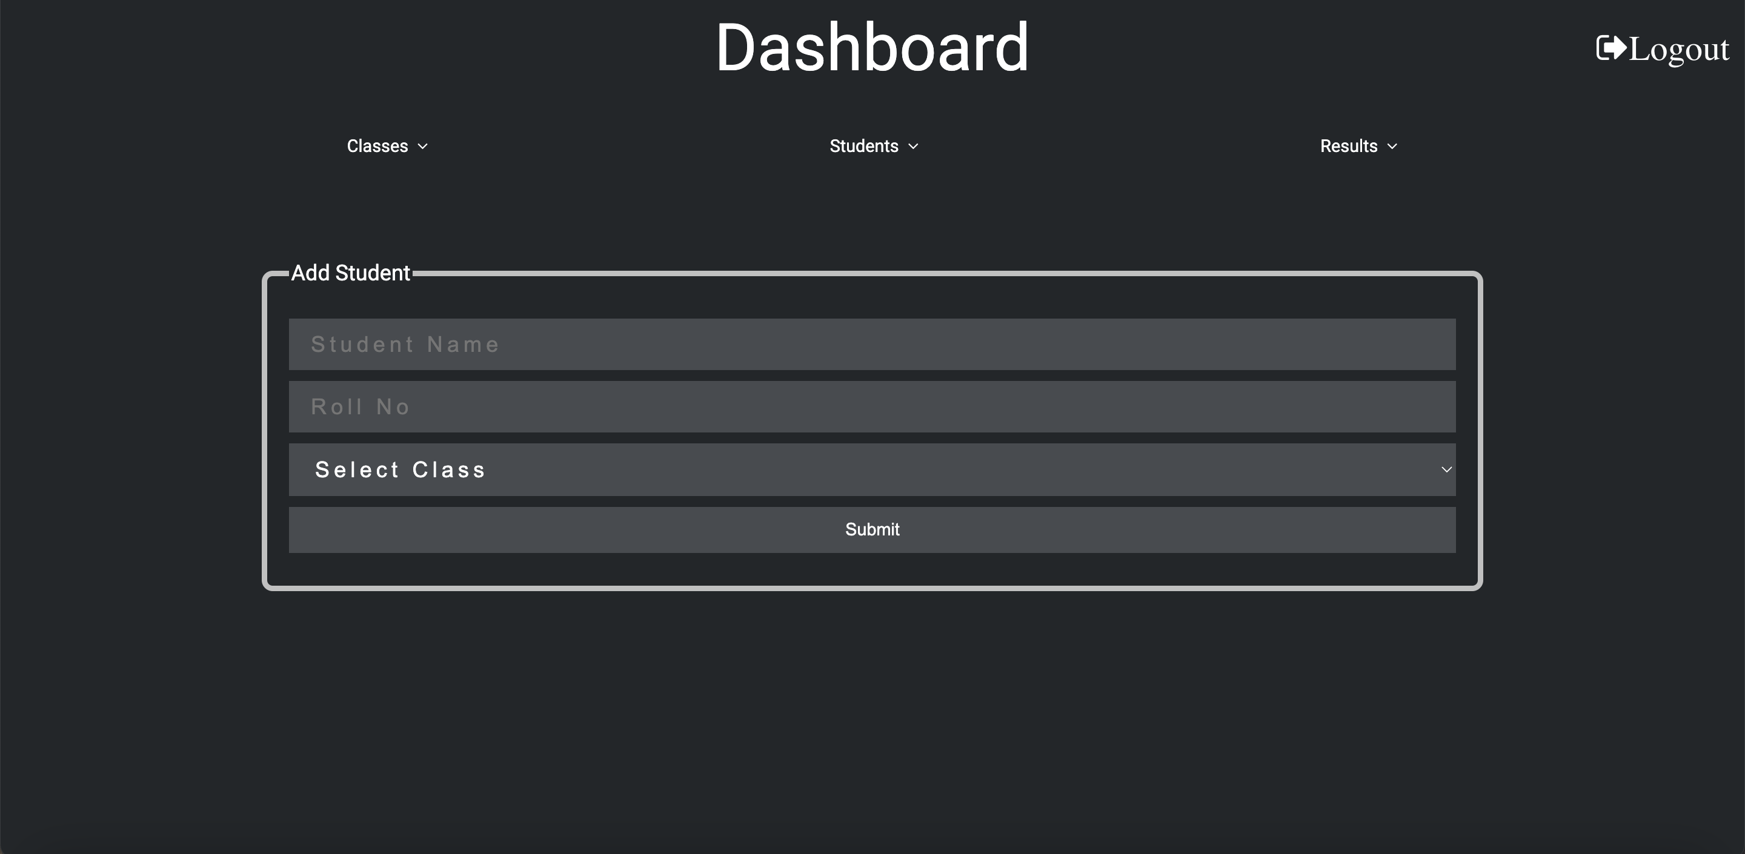
Admin Add The Students

Slide 15
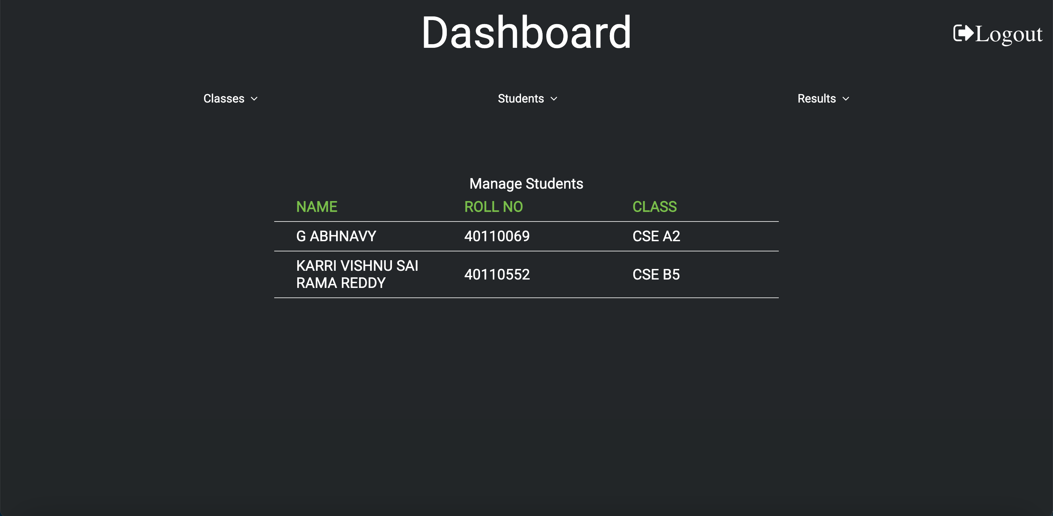
Admin Manages The Students

Slide 16
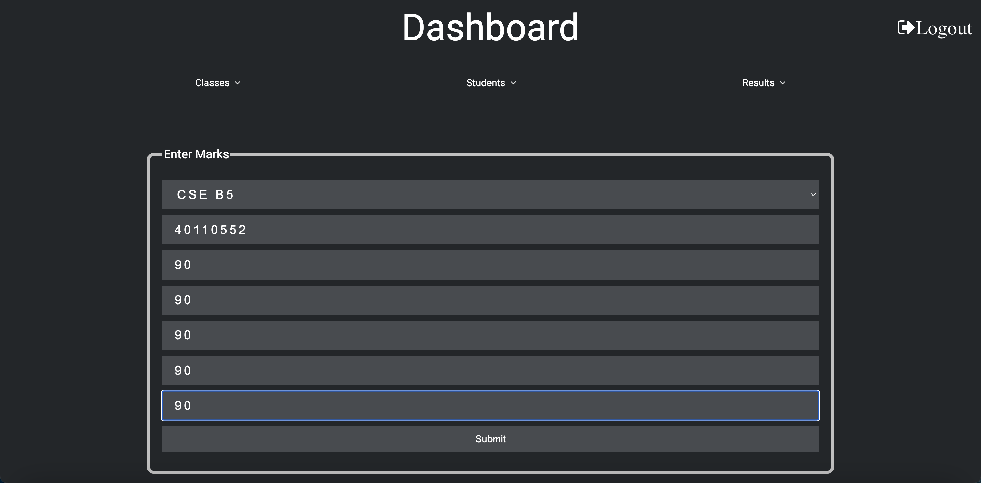
Admin Add The Students Results

Slide 17
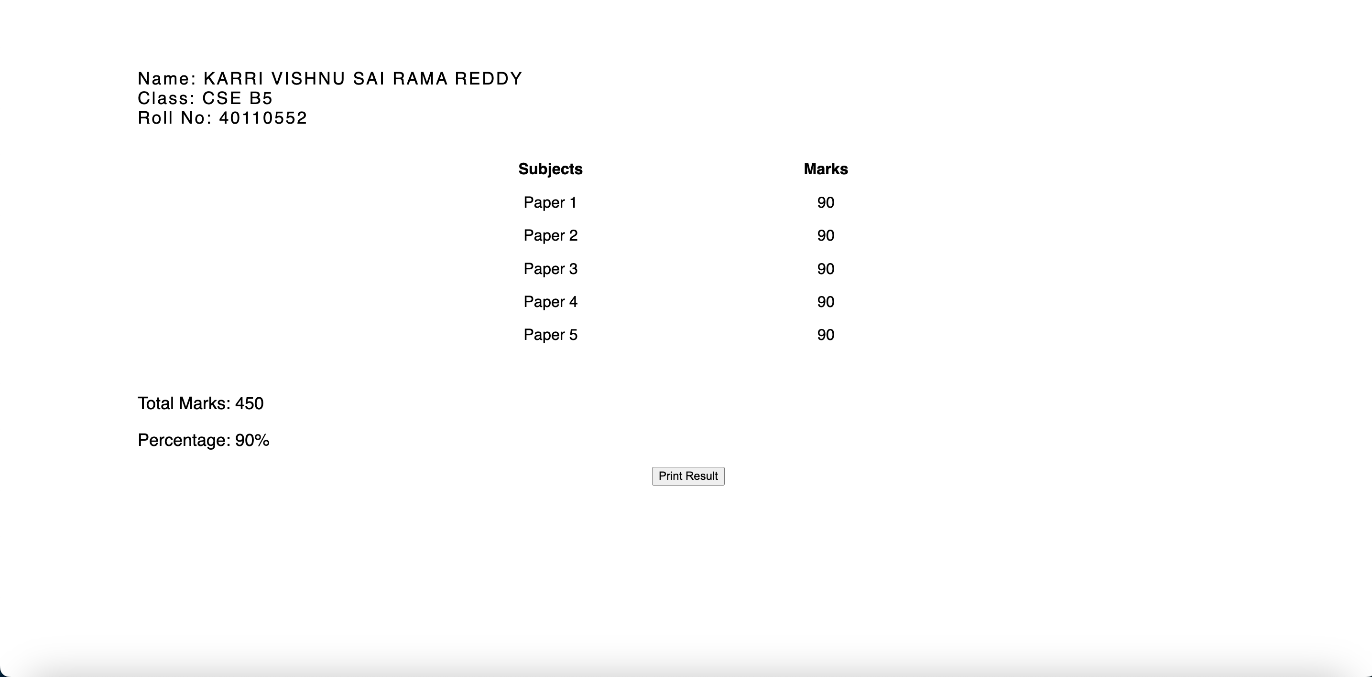
Student Result Dashboard

Slide 18
Result and Conclusion
In conclusion, this Paper introduces a software program that can store and process student scores at the tick of a one key and present the result in the needed format. Its features have enabling the flawless enrollment, reduced cost and computer-time student results, faster production of term results for each classes and enabling faculties and administrators/admins to view all classroom term results on a single sheet which is broadsheet and summary of results for the all class, the application is very easy to use, moderately secure and enforces data integrity resulting from the use of a related database management system(DBMS). Properly implemented software design will solve problems associated with the analysis of student outcomes in educational institutions by setting up an effective computerized data processing system.
Speed
Simplicity

Slide 19
Reference
Sharifovna, X. Z., Taxirovna, A. M., Akmalovna, N. D., Askarjanovna, S. N., Akramovna, A. N., & Isroilqizi, U.I. (2021). Marketing Research of Medicines Used in Urinary Infectious Diseases. Annals of the Romanian Societyfor Cell Biology, 5177-5180
Matkarimov, R. M., Yunusov, S. A., & Khodjaev, A. Z.(2019). Teoriya i metodika tyazheloj atletiki [The theoryand methodology of weightlifting]. Tashkent: Scientific and technical information.
https://www.geeksforgeeks.org

Slide 20
THANK YOU!

